Slide 1
IoT Meetup #9
PCB design - Workshop

Slide 2
Agenda
1. Intro
Setting up
Simplified PCB design process
2. PCB design
Drawing the schematic – components and selection
Placing components and tracing of the PCB
Exporting your design for production
Different option for making your PCB
Questions and open discussion on related topics
3. Open discussion for the meetup
Your inputs, ideas and feedback
Future suggestion for meetup topics

Slide 3
How hardware is born? The simple story
Circuit diagram
PCB design
PCB production
Assembly
Testing – bring up

Slide 4
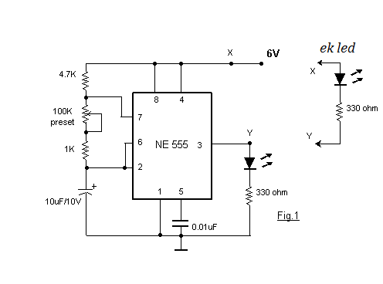
Circuit Diagram
Notes:
A circuit diagram (electrical diagram, elementary diagram, electronic schematic) is a graphical representation of an electrical circuit
While doing that we should also take care of picking up the components.

Slide 5
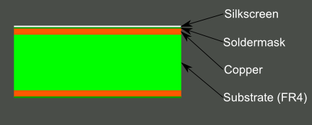
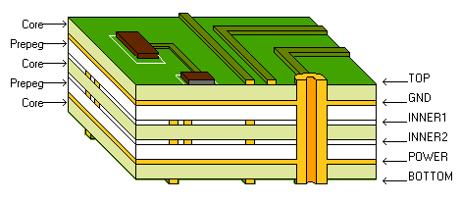
PCB design 1 – What is a PCB?
PCB - Printed circuit board
A printed circuit board (PCB) mechanically supports and electrically connects electronic components using conductive tracks, pads and other features etched from copper sheets laminated onto a non-conductive substrate. (Wikipedia)
Could be anywhere from 1 to 16 or even more layers

Slide 6
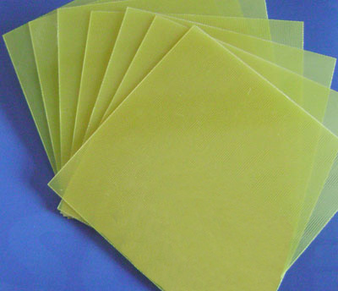
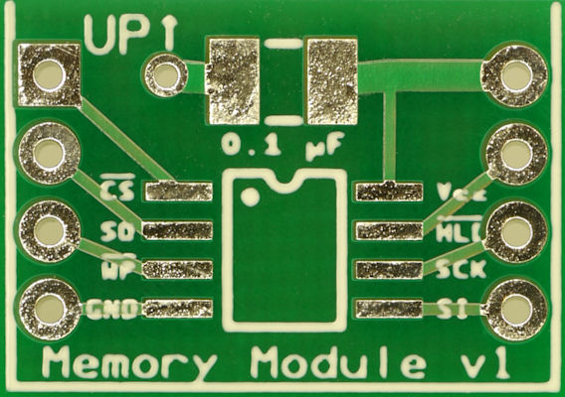
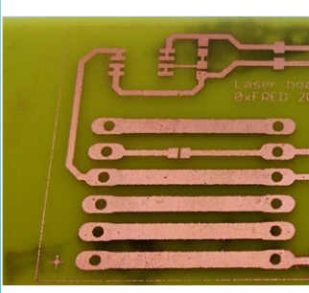
PCB - Features
Via
Silkscreen - white
Solder mask - green
FR4 – most widely used glass-reinforced epoxy laminate sheets
Copper – underneath the solder mask
Plated Through-Hole
Trace(s)
SMT Pad

Slide 7
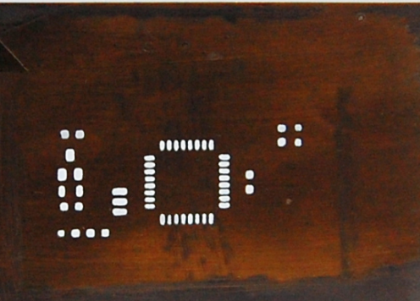
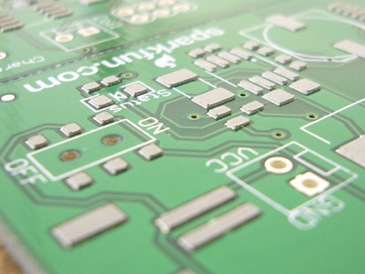
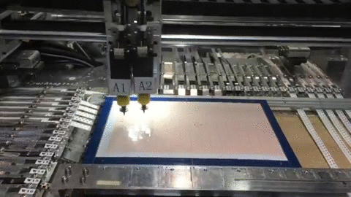
PCB assembly
Stencil
Solder paste
Pick and place machine
Reflow Oven

Slide 8
CircuitMaker
“Free” community based tool for PCB design (EDA tool – electronic design automation)
Up to 2 sandboxed designs, others should be public.
By Altium – their profesional grade product is Altium Designer
Has a very cool 3D feature ☺
Rule based system

Slide 9
What is a component
Symbol
Footprint
3D
Simulation data

Slide 10
Entering the schematic
Shouldn’t and will not look the same.
Some Hints:
Look for components with models
Space to rotate component
W to start wiring
Z and V for placing GND and VCC port respectively

Slide 11
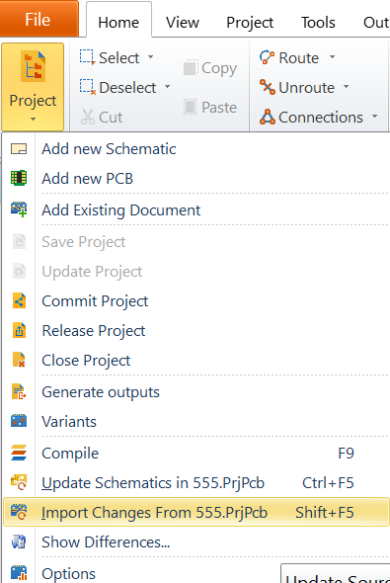
PCB – Kick off & Import schematic
Setting up the design rules
Drawing the PCB outline
Importing Schematic

Slide 12
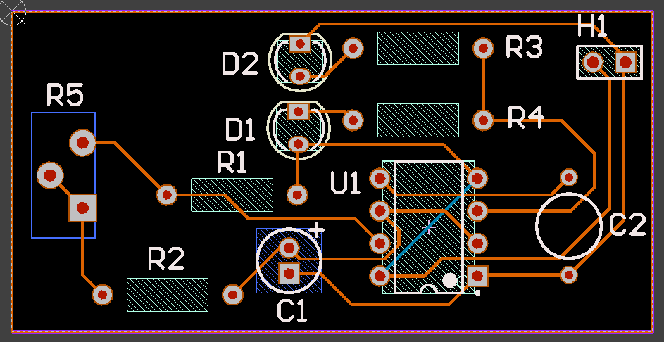
PCB – Routing
Start by arranging your components
R to route
Shift + R – Change interactive routing mode
Space to rotate components
Change component layer by right click and select other layer
CTRL+ALT+SHIFT scroll to change layer while tracing with via.

Slide 13
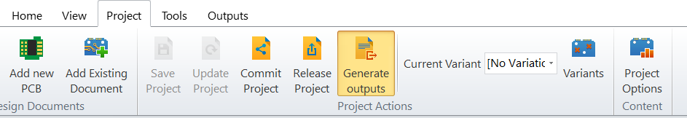
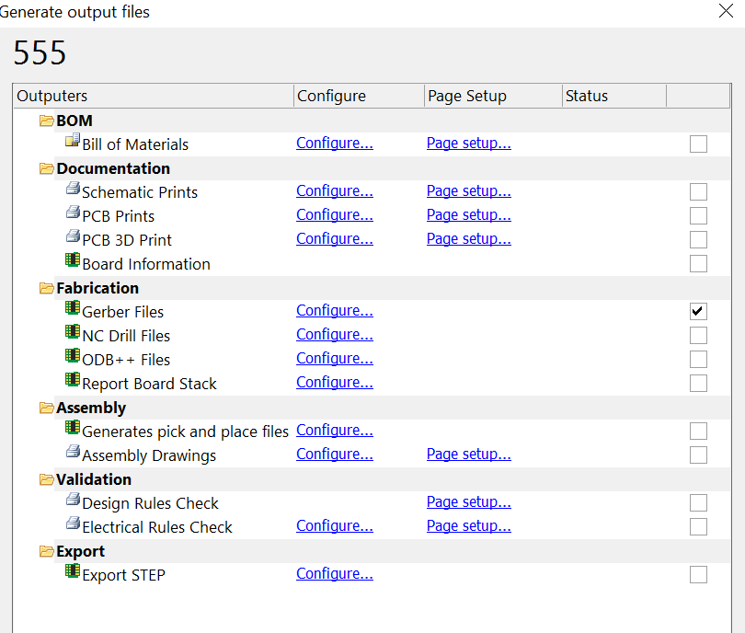
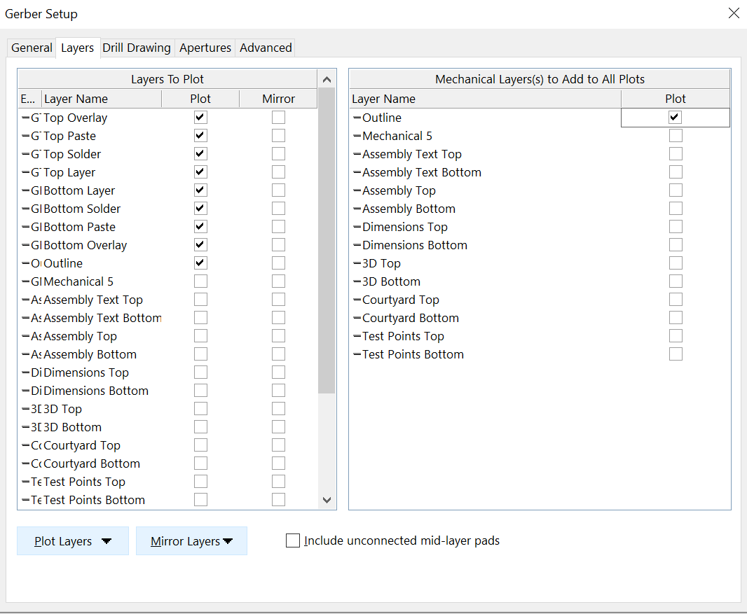
Exporting for Production – Gerber files

Slide 14
Exporting for Production – check
Gerber files
http://www.gerber-viewer.com/
And import layer by layer

Slide 15
Options for making PCBs – DIY #1
Appropriate for single layer
Option 1: Laser printer, Iron and FeCl3 for etching, drill and drill bits for holes
Print he layer with a laser printer on a glossy paper (pro tip ;) get a big printer that doesn’t bend the paper and remote its heating element )
Put the paper on the FR4 blank and heat with a iron, the toner should stick to the FR4.
Put in FeCl3 – use with caution.
Wash and finish with drilling, etc.

Slide 16
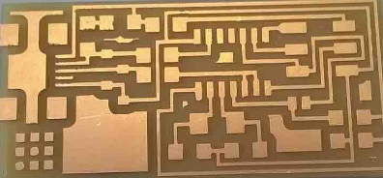
Options for making PCBs – DIY #2
Use a CNC to mill out copper from FR4
Use http://flatcam.org/ to open your gerber files and set up the CNC
Some experimentation is required

Slide 17
Options for making PCBs
Pay 10 bucks to China ☺
I have been using for 2-4 layer prototype PCB
No problems for now
Very short lead times – 2-3 days (2-3 more for delivery).
http://www.pcbway.com/orderonline.aspx

Slide 18
IoT Meetup DK - What’s next
Any ideas for next meetings?
- Google Dartuino talk – Uffe
- UX into IoT – Thomas (Service design toolkit for IoT)
- Lora – Alex and Rene
- Green grass platform – Uffe
- Voice services/voice reconginition – Uffe
- Home automation with RPi – Robert
- RF/antenna design ? – Circuit simulation – Boyan
- Show day – bring your project and show what you have done - Thomas
May 2017 – Acal Bfi, Sierra Wireless will hold a workshop for their mobile platform

